Slide 1


Software Engineering
Practical workshop

Slide 2

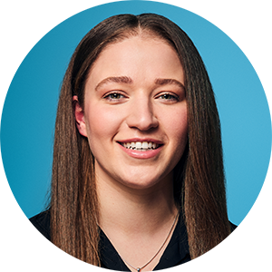
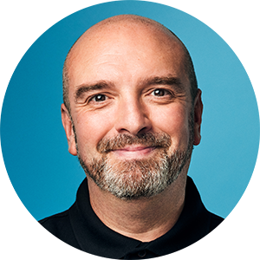
Agenda & key information
Tonight’s agenda
18:30 Welcome & introductions
18:35 Q&A time with Ed
18:45 Software Engineering practical activity
19:15 Reflections and finish
Your hosts this evening
Emily Hill Industry Engagement Associate
Ed Wright Software Engineering Training Lead

Slide 3


Workshop Q&A
Your chance to ask your coach for the Software Engineering pathway your questions.
Raise your “Zoom hand” to ask a question and we’ll invite you to unmute yourself
Find out more about what the Software Engineering pathway is all about
Questions we are often asked include:
What technologies will I learn about?
What does a typical day look like?
What is included in the curriculum?
Will I work on my own or as part of a team?

Slide 4


Software Engineering Taster Activity
We will randomly assign you into small groups in breakout rooms
Step 1: Introduce yourselves to your new team.
Step 2: Share your name, studies and why you're here this evening.
First, there'll be a short demonstration and then the time is all yours with your pair partner to start writing some simple code.
It doesn't matter where you get to.
Have fun learning together!

Slide 5
Software Engineering Taster Activity
Tasks
Navigate to the GitHub repository:
https://github.com/digital-futures-academy/taster-tic-tac-toe
Open the CodePen starter and work through the activities – use your group as support if you get stuck – sharing screens is a great way to get help! Follow the timing guides if you can.
You will:
Add some HTML to a page
Apply some styling to HTML via CSS
Make the HTML page interactive by editing and adding some JavaScript
Problem Solving: If you get stuck, use these steps.
Double check the resources available in your current step
Check the solution files sign-posted
Use the raise hand feature in the zoom breakout and someone will jump into your room to help.

Slide 6

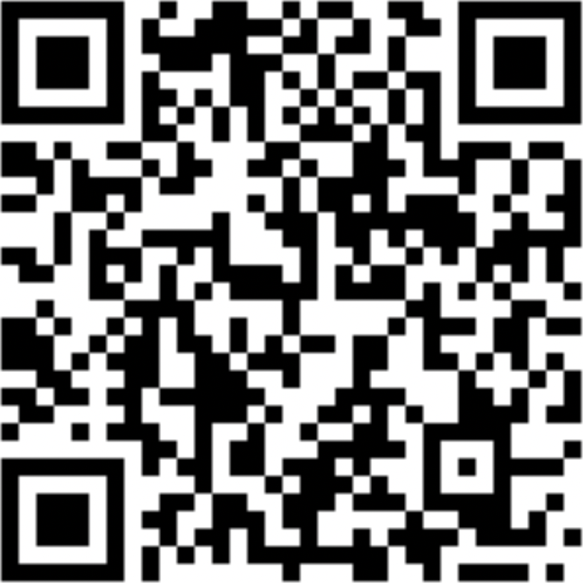




digitalfutures.com

